Slide 1
INTERNSHALA PROJECT TASK 11
Mohammed Danish Adnaan Video Explanation Link : Internshala SQL Project Explanation “link” Email : danishadnaan2003@gmail.com
Drive Link:
https://drive.google.com/file/d/1cnfd4ETCxR6_ZRfpO_CJHAjWcH-u8XR8/view?usp=sharing

Slide 2
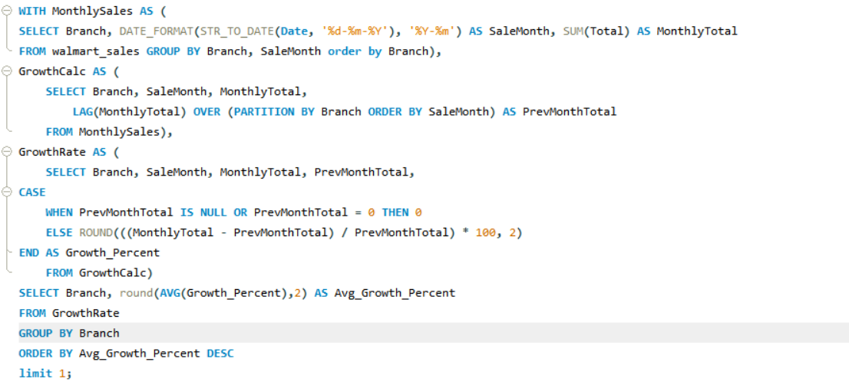

INTERNSHALA PROJECT
Query:
Task 1:
Identifying the Top Branch by Sales Growth Rate (6 Marks)
Walmart wants to identify which branch has exhibited the highest sales growth over time. Analyze the total sales for each branch and compare the growth rate across months to find the top performer.
Output 1:

Slide 3
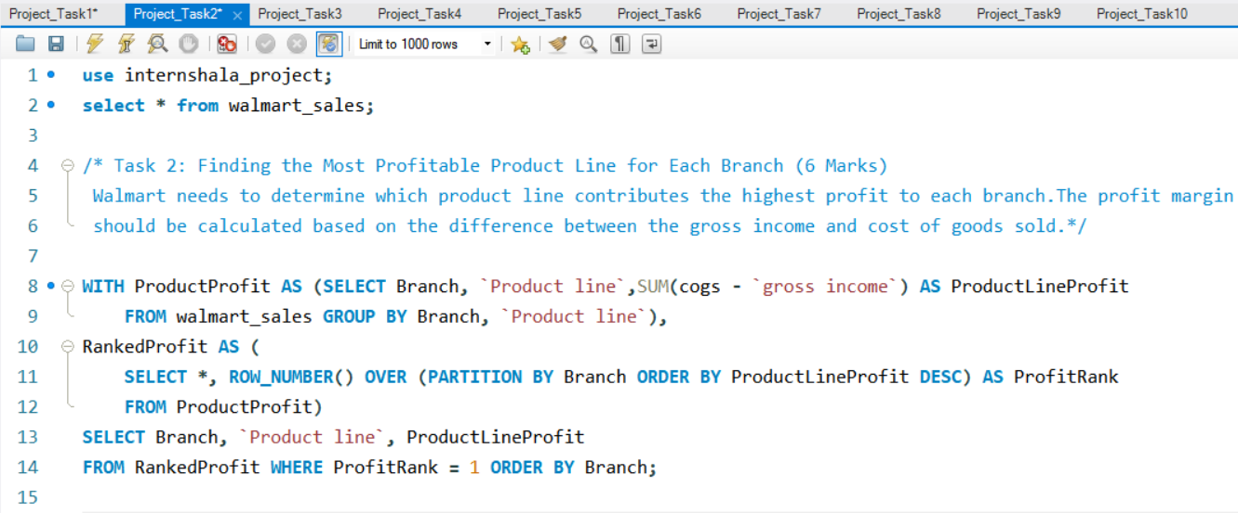
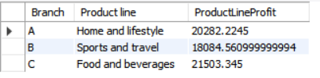
INTERNSHALA PROJECT
Query:
Task 2:
Finding the Most Profitable Product Line for Each Branch (6 Marks)
Walmart needs to determine which product line contributes the highest profit to each branch. The profit margin should be calculated based on the difference between the gross income and cost of goods sold.
Output 2:

Slide 4
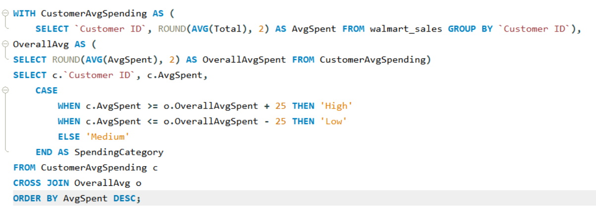
INTERNSHALA PROJECT
Query:
Task 3:
Analyzing Customer Segmentation Based on Spending (6 Marks)
Walmart wants to segment customers based on their average spending behavior. Classify customers into three tiers: High, Medium, and Low spenders based on their total purchase amounts.
Output 3:

Slide 5
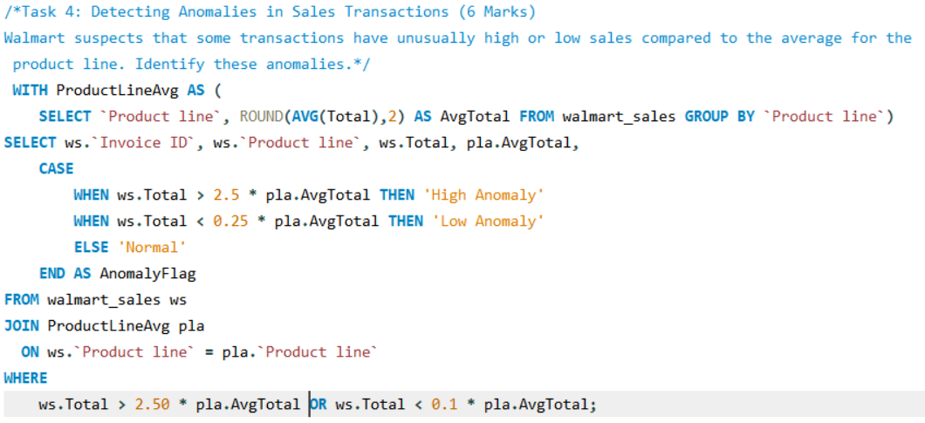
INTERNSHALA PROJECT
Output 4:
Task 4:
Detecting Anomalies in Sales Transactions (6 Marks)
Walmart suspects that some transactions have unusually high or low sales compared to the average for the product line. Identify these anomalies.
Query:

Slide 6
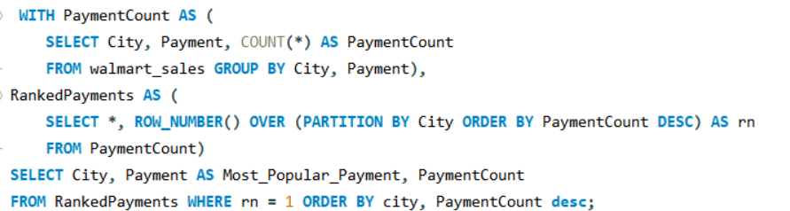

INTERNSHALA PROJECT
Query:
Task 5:
Most Popular Payment Method by City (6 Marks)
Walmart needs to determine the most popular payment method in each city to tailor marketing strategies.
Output 5:

Slide 7
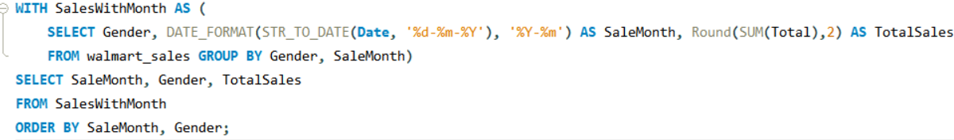
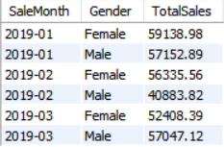
INTERNSHALA PROJECT
Task 6:
Query:
Monthly Sales Distribution by Gender (6 Marks)
Walmart wants to understand the sales distribution between male and female customers on a monthly basis.
Output 6:

Slide 8
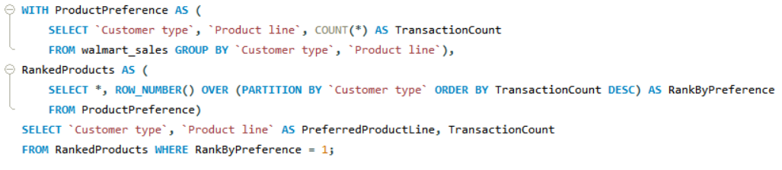

INTERNSHALA PROJECT
Task 7:
Query:
Best Product Line by Customer Type (6 Marks)
Walmart wants to know which product lines are preferred by different customer types(Member vs. Normal).
Output 7:

Slide 9
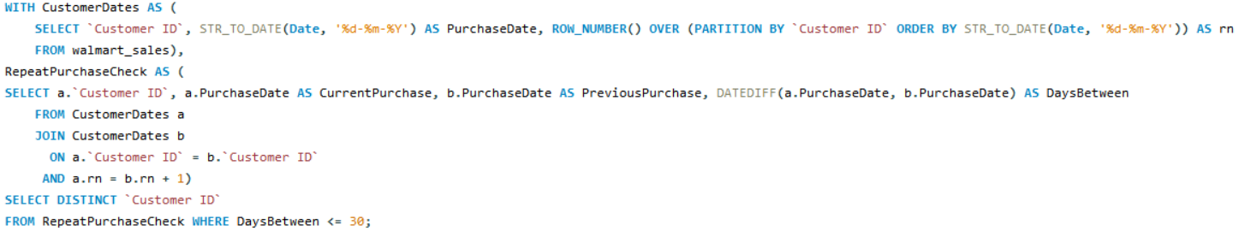

INTERNSHALA PROJECT
Task 8:
Query:
Identifying Repeat Customers (6 Marks)
Walmart needs to identify customers who made repeat purchases within a specific time frame (e.g., within 30 days).
Output 8:

Slide 10
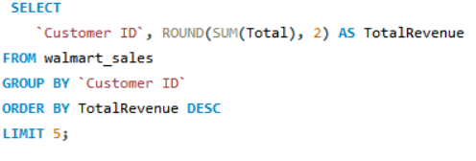
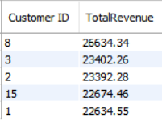
INTERNSHALA PROJECT
Task 9:
Query:
Finding Top 5 Customers by Sales Volume (6 Marks)
Walmart wants to reward its top 5 customers who have generated the most sales Revenue.
Output 9:

Slide 11
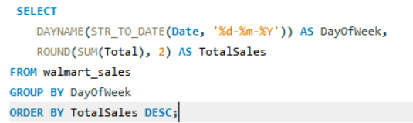
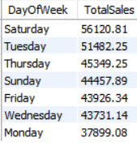
INTERNSHALA PROJECT
Task 10:
Query:
Analyzing Sales Trends by Day of the Week (6 Marks)
Walmart wants to analyze the sales patterns to determine which day of the week brings the highest sales.
Output 10:

Slide 12
Walmart Sales Data Analysis: Key Insights Summary
Advanced SQL analysis of Walmart’s sales data reveals critical insights for strategic decision-making. Branch A leads with the highest sales growth rate of 1.11%, showcasing its potential as a model for others. Profitability varies by branch, with "Home and lifestyle" topping Branch A, "Sports and travel" in Branch B, and "Food and beverages" in Branch C, suggesting branch-specific product strategies. Customer spending segmentation into High, Medium, and Low categories supports targeted marketing, while anomaly detection flags unusual transactions for fraud prevention. Payment preferences differ by city ‘E-wallet’ prevails in Mandalay and Yangon, Cash in Naypyitaw guiding payment system enhancements. Sales remain gender-balanced with monthly fluctuations, and customer types show distinct preferences: Members favor "Food and beverages," Normal customers opt for "Electronic accessories.“
Additionally, identifying repeat customers and the top 5 spenders (e.g., Customer 8 at $26,634.34) enables tailored loyalty programs. Sales peak on Saturdays, followed by Tuesdays, informing staffing and promotional schedules. Product line popularity by customer type and payment trends by city further refine marketing efforts, while monthly gender-based sales and anomaly insights enhance operational oversight. These findings empower Walmart to optimize sales, boost customer engagement, and streamline operations through data-driven approaches.

Slide 13
THANK YOU

